Slide 1
In the name of Allah, most gracious and merciful
Object Oriented Concepts &Design with Lab
Lecture – 5
Relation
Interface

Slide 2
Inheritance

Slide 3
Relation between objects
Is-A-relation
Has-A-relation

Slide 4
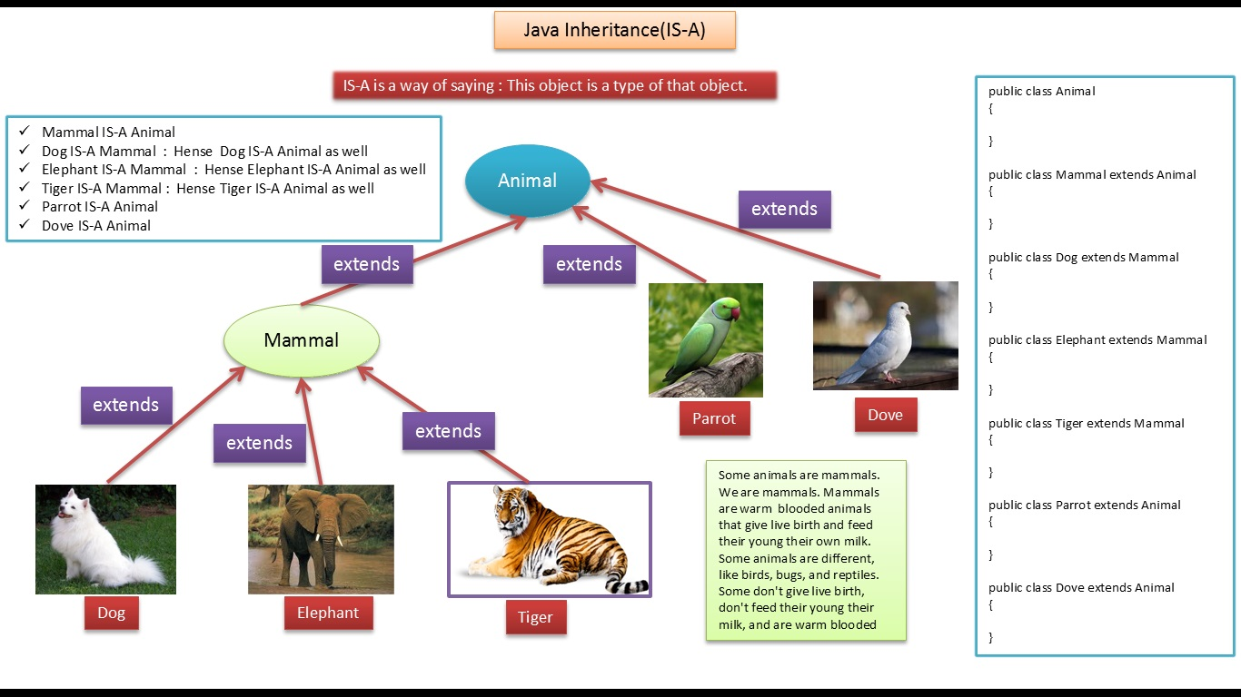

Slide 5
Is-A-relation
This refers to inheritance or implementation.
Expressed using keyword “extends”.
Main advantage is code reusability.

Slide 6
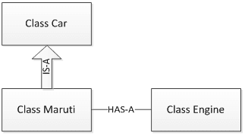
Has-a-relation

Slide 7
Has-A-relation
Has-A means an instance of one class “has a” reference to an instance of another class or another instance of same class.
It is also known as “composition” or “aggregation”.
There is no specific keyword to implement HAS-A relationship but mostly we are depended upon “new” keyword.

Slide 8
Has-A-relation
Composition(HAS-A) simply mean the use of instance variables that are references to other objects. For example Maruti has Engine, or House has Bathroom.

Slide 9
class Car {
private String color;
private int maxSpeed;
public void carInfo(){
Console.WriteLine("Car Color= "+color + " Max Speed= " + maxSpeed);
}
public void setColor(String color) {
this.color = color;
}
public void setMaxSpeed(int maxSpeed) {
this.maxSpeed = maxSpeed;
}
}

Slide 10
class Maruti extends Car{
public void MarutiStartDemo(){
Engine MarutiEngine = new Engine();
MarutiEngine.start();
}
}
package relationships;
public class Engine {
public void start(){
Console.WriteLine("Engine Started:");
}
public void stop(){
Console.WriteLine("Engine Stopped:");
}
}
public class RelationsDemo {
public static void main(String[] args) {
Maruti myMaruti = new Maruti();
myMaruti.setColor("RED");
myMaruti.setMaxSpeed(180);
myMaruti.carInfo();
myMaruti.MarutiStartDemo();
}
}

Slide 11
Types of Inheritance
Single Inheritance
Multi Level Inheritance
Hierarchical Inheritance
Multilevel Inheritance

Slide 12
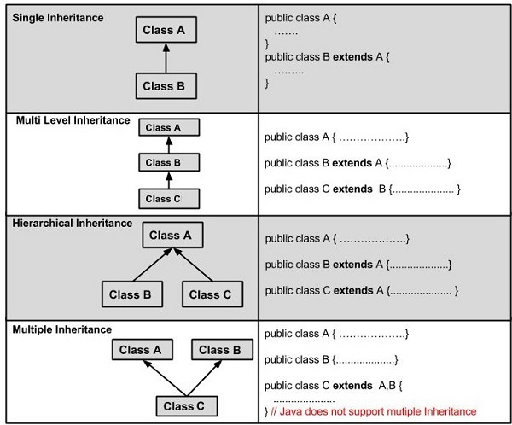

Slide 13
Multiple Inheritance
Multiple inheritance : using interface

Slide 14
What is interface
An interface in java is a blueprint/template/structure of a class. It has static constants and abstract methods only.
An interface is defined as a syntactical contract that all the classes inheriting the interface should follow. The interface defines the 'what' part of the syntactical contract and the deriving classes define the 'how' part of the syntactical contract.

Slide 15
Why interface
Interfaces define properties, methods, and events, which are the members of the interface. Interfaces contain only the declaration of the members. It is the responsibility of the deriving class to define the members. It often helps in providing a standard structure that the deriving classes would follow.

Slide 16
Declaring Interfaces
Interfaces are declared using the interface keyword. It is similar to class declaration. Interface statements are public by default. Following is an example of an interface declaration:
public interface ITransactions { // interface members void showTransaction(); double getAmount(); }

Slide 17
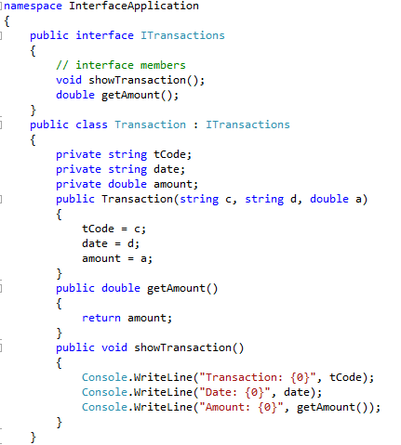

Slide 18
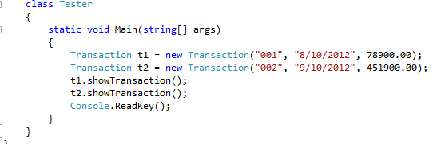

Slide 19
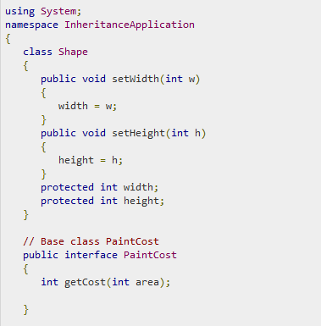
Multiple inheritance

Slide 20
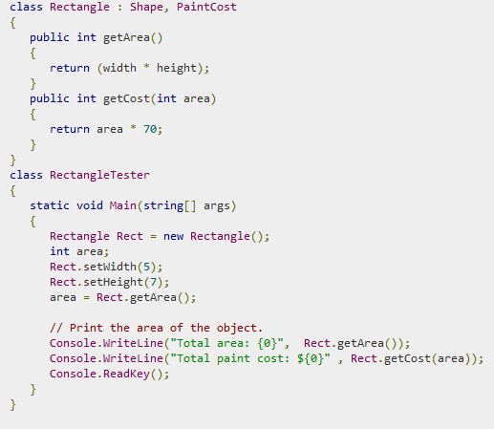

Slide 21
Interface : Example
Circle, rectangle – these 2D shapes have a job have to be done which is calculating the area of those shapes, again cone, cylinder – these 3D shapes will calculate the area of shapes and the volume of the shapes also.
On the above situation, implement the concept of interface.

Slide 22
Interface : Example
In Ab Office, there are managers, stuffs and cleaners who have attributes like id and name. For all employees of that company monthly salary must be calculated. For salary calculation consider that manager, stuff and cleaner get daily 500, 300, 100 taka respectively.
Design proper classes with implementing inheritance. [Interface must be implemented]

